Slide 1


Intro to Xamarin
Developing cross-platform apps with C# and XAML
Dipesh Trikam & Jackie Chan

Slide 2







What is Xamarin
Visual Appearance
Behaviour
XAML
Code-Behind

Slide 3

MVVM Pattern
What
Structure for code
Why
Maintainable and reusable
When
Heavyweight programs

Slide 4
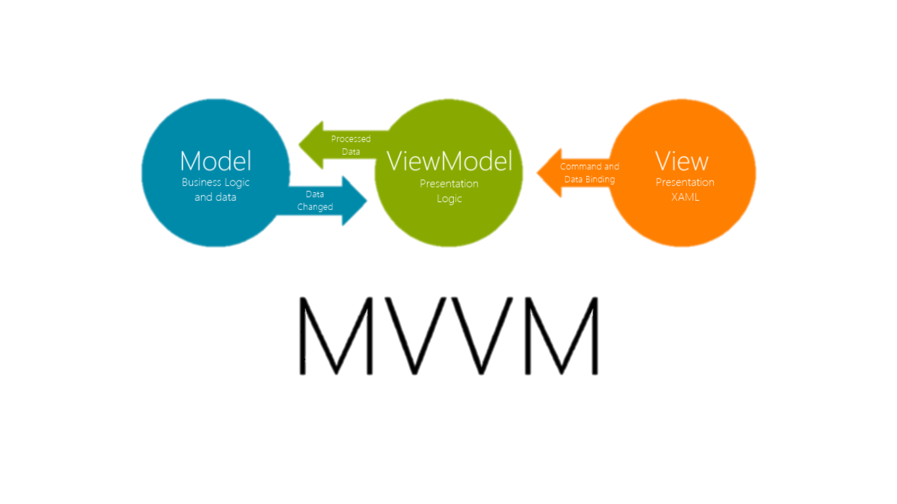
MVVM Pattern
Reference
Data Binding
Objects e.g. Buttons
Data Entities
Logic

Slide 5
Sharing Code Options
Portable Class Library
(PCL)
Shared Project
Targets platforms
Uses interfaces to provide platform-specific functionality
Uses Shared Asset Project (SAP) type to organise source code
Uses #if, #elif and #endif compiler directives
Notes:
Now for sharing code options. There are 3 methods available between cross platform applications, and today we will be going through 2 of the main ones: PCL and SL. We recommend using PCL or portable class library as the code is cleaner and hence more readable.
So, the main difference between PCL and SAP is how we deal with platform-specific
code:
• PCL: Using the Device class
• SAP: Using preprocessor directives (#if, #elif, #endif)

Slide 6
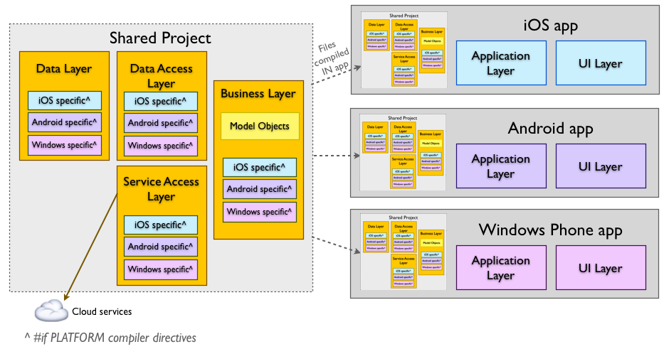
Shared Project

Slide 7
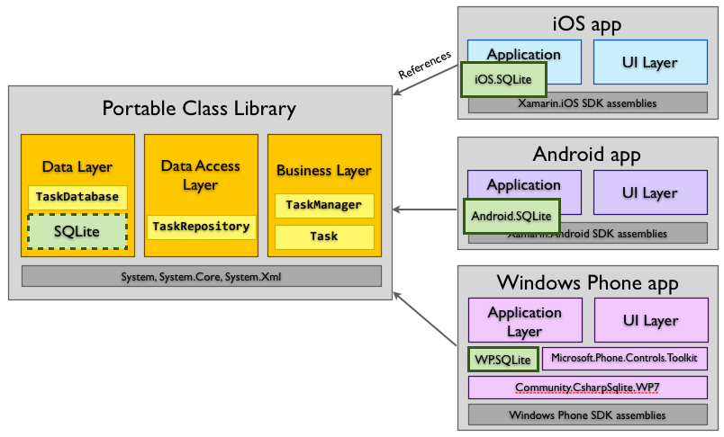
Portable Class Library

Slide 8
Platform specific code
Portable Class Library
(PCL)
Shared Project
if (Device.OS == TargetPlatform.iOS) { … }
else if (Device.OS == TargetPlatform.Android) { … }
#if __IOS__
…
#elif __ANDROID__
…
#endif

Slide 9
Thank you

